Slide 1
5 Demonstrations
Ferhat Erata (UNIT, WP3 Leader)
Emre Kirmizi (UNIT, Technical Contact)
Dr. Claire Gardent (CNRS/LORIA, WP2 Leader)
Bikash Gyawali (CNRS/LORIA, Technical Contact)
Anastasia Shimorina (CNRS/LORIA, Technical Contact)
Dr. Geylani Kardas (KOCSISTEM, Consultant)

Slide 2
What is a text?

Slide 3
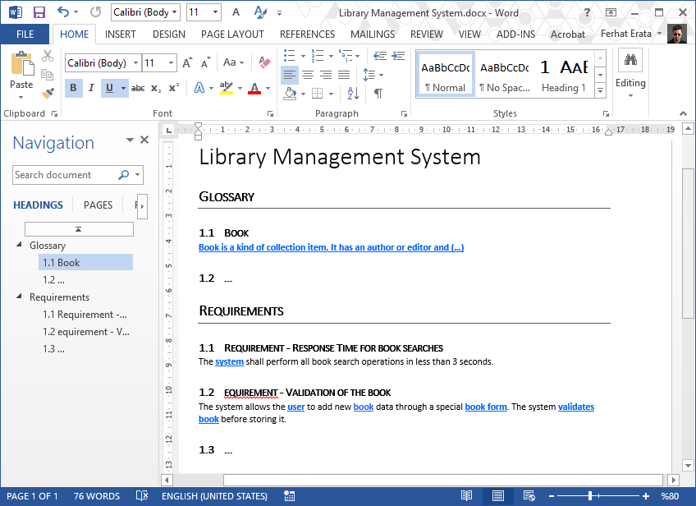
What is a text? (document file formats) Office Open XML (.docx) (ISO/IEC 29500)

Slide 4
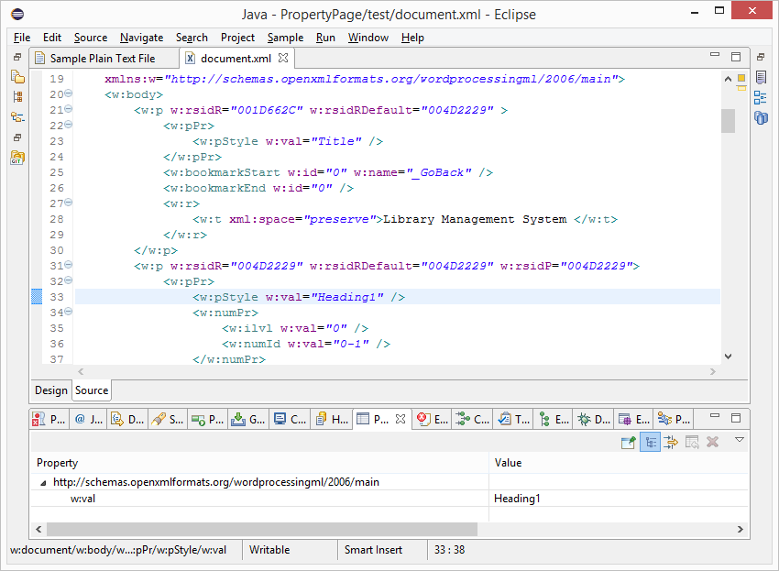
What is a text? (document file formats) Office Open XML (.docx) (ISO/IEC 29500)

Slide 5
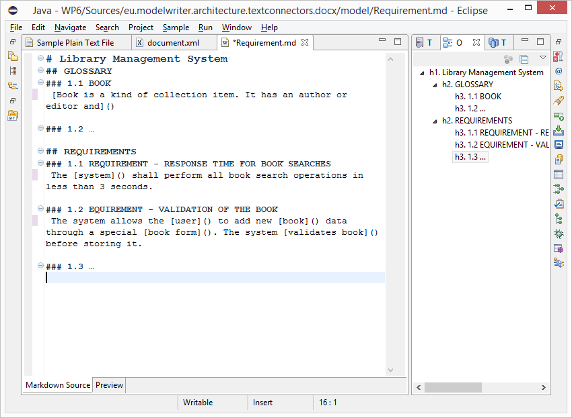
What is a text? (.md source file) text/markdown (ICANN Standard)

Slide 6
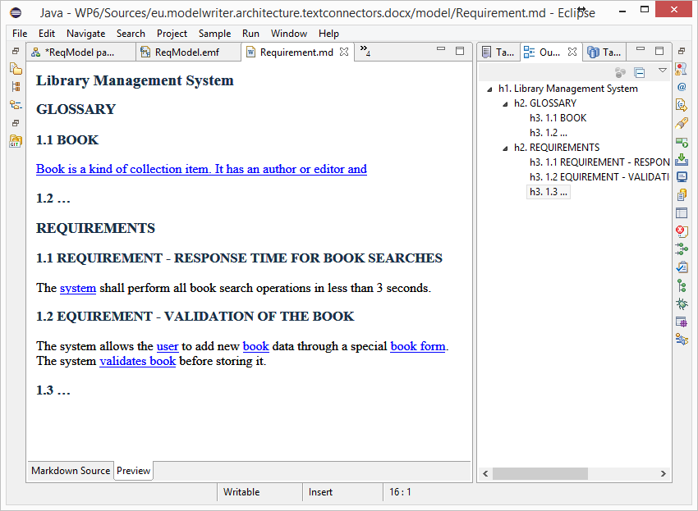
What is a text? (HTML Preview) text/markdown (ICANN Standard)

Slide 7
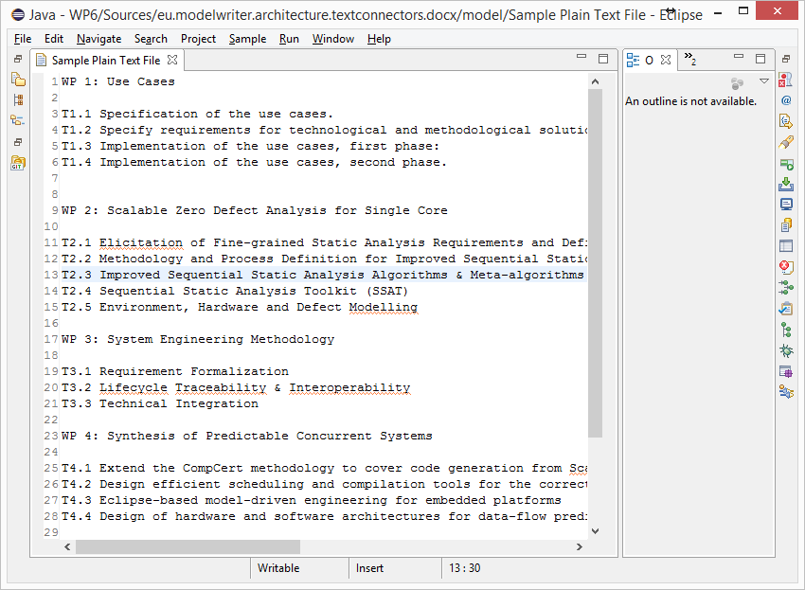
What is a text? (unformatted text) text/plain (ICANN Standard)

Slide 8
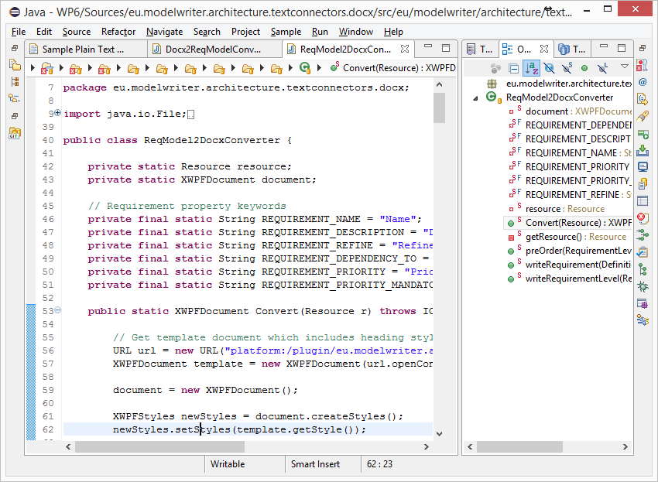
What is a text? (code files) Java, C++ … Programing Languages

Slide 9
What is a model?

Slide 10
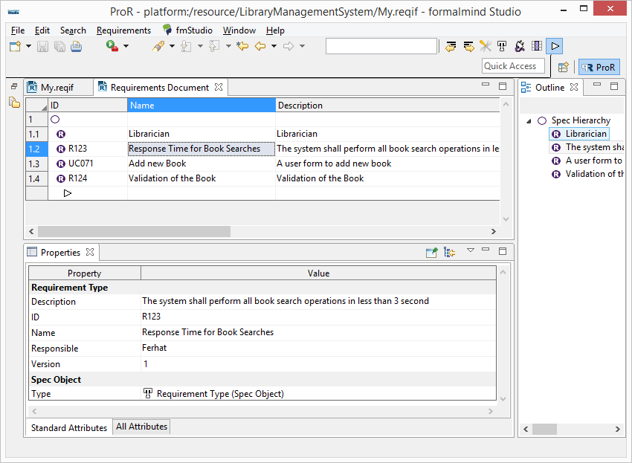
Everything is a model! (ReqIF Standard) Requirements Interchange Format

Slide 11
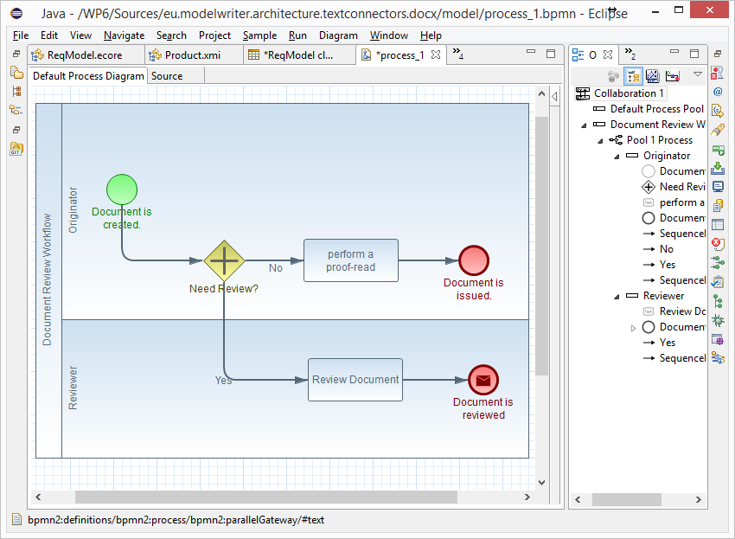
Everything is a model! (BPMN Standard) Business Process Model & Notation

Slide 12
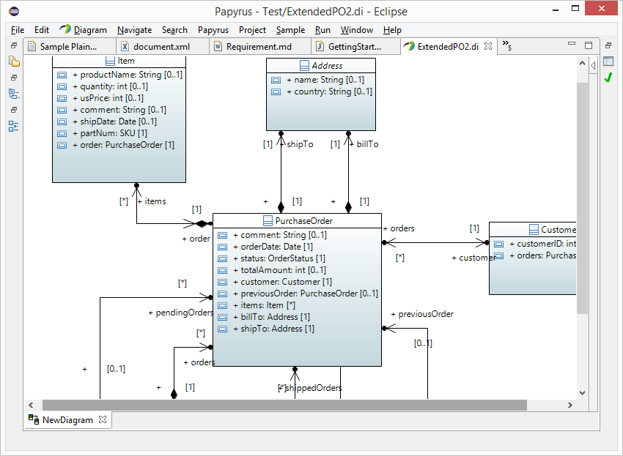
Everything is a model! (UML Standard) UML Modeling Languages

Slide 13
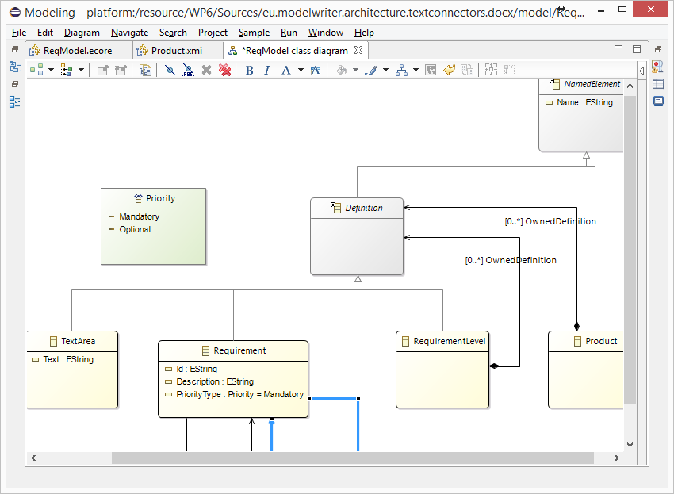
Everything is a model! Eclipse Modeling Framework (EMF)

Slide 14
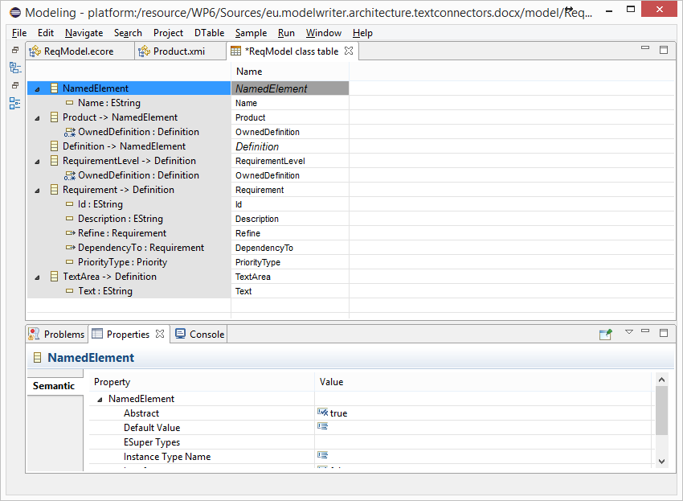
Everything is a model! Tree-based or Tabular Representations

Slide 15
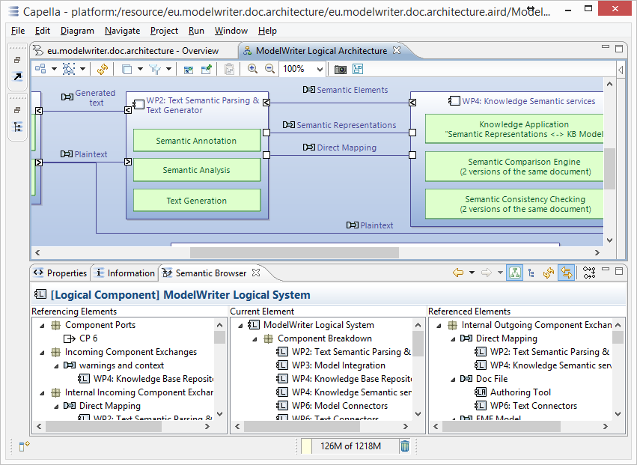
Everything is a model! Software/System Architecture Design

Slide 16
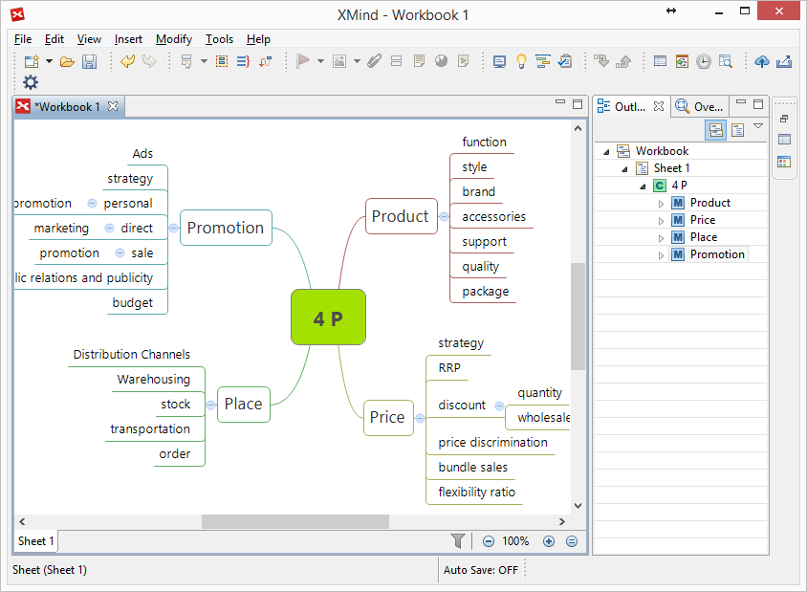
Everything is a model! Topic Maps, Mind Maps, Vocabularies …

Slide 17
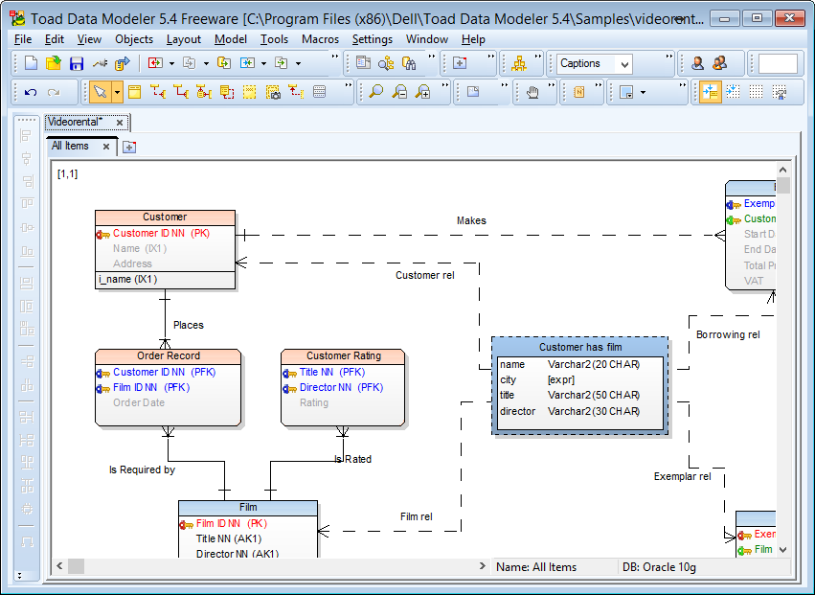
Everything is a model! Databases (ER, IDEF1.x)

Slide 18
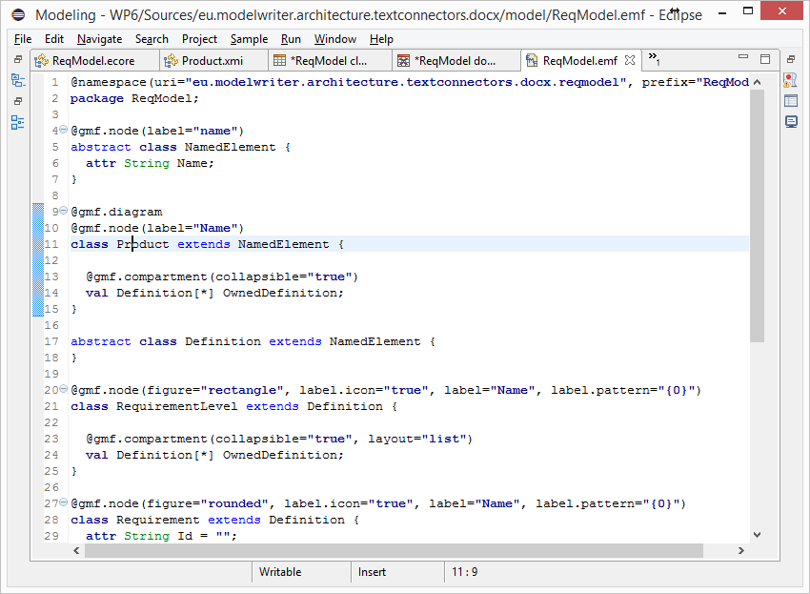
Everything is a model! (Textual Lang.) Domain Specific Languages

Slide 19
Everything is a model! (Java, C++, etc.) Even Programing Languages (ASTs)

Slide 20
Is it possible to connect and keep arbitrary software/system engineering artifacts synchronized ?

Slide 21
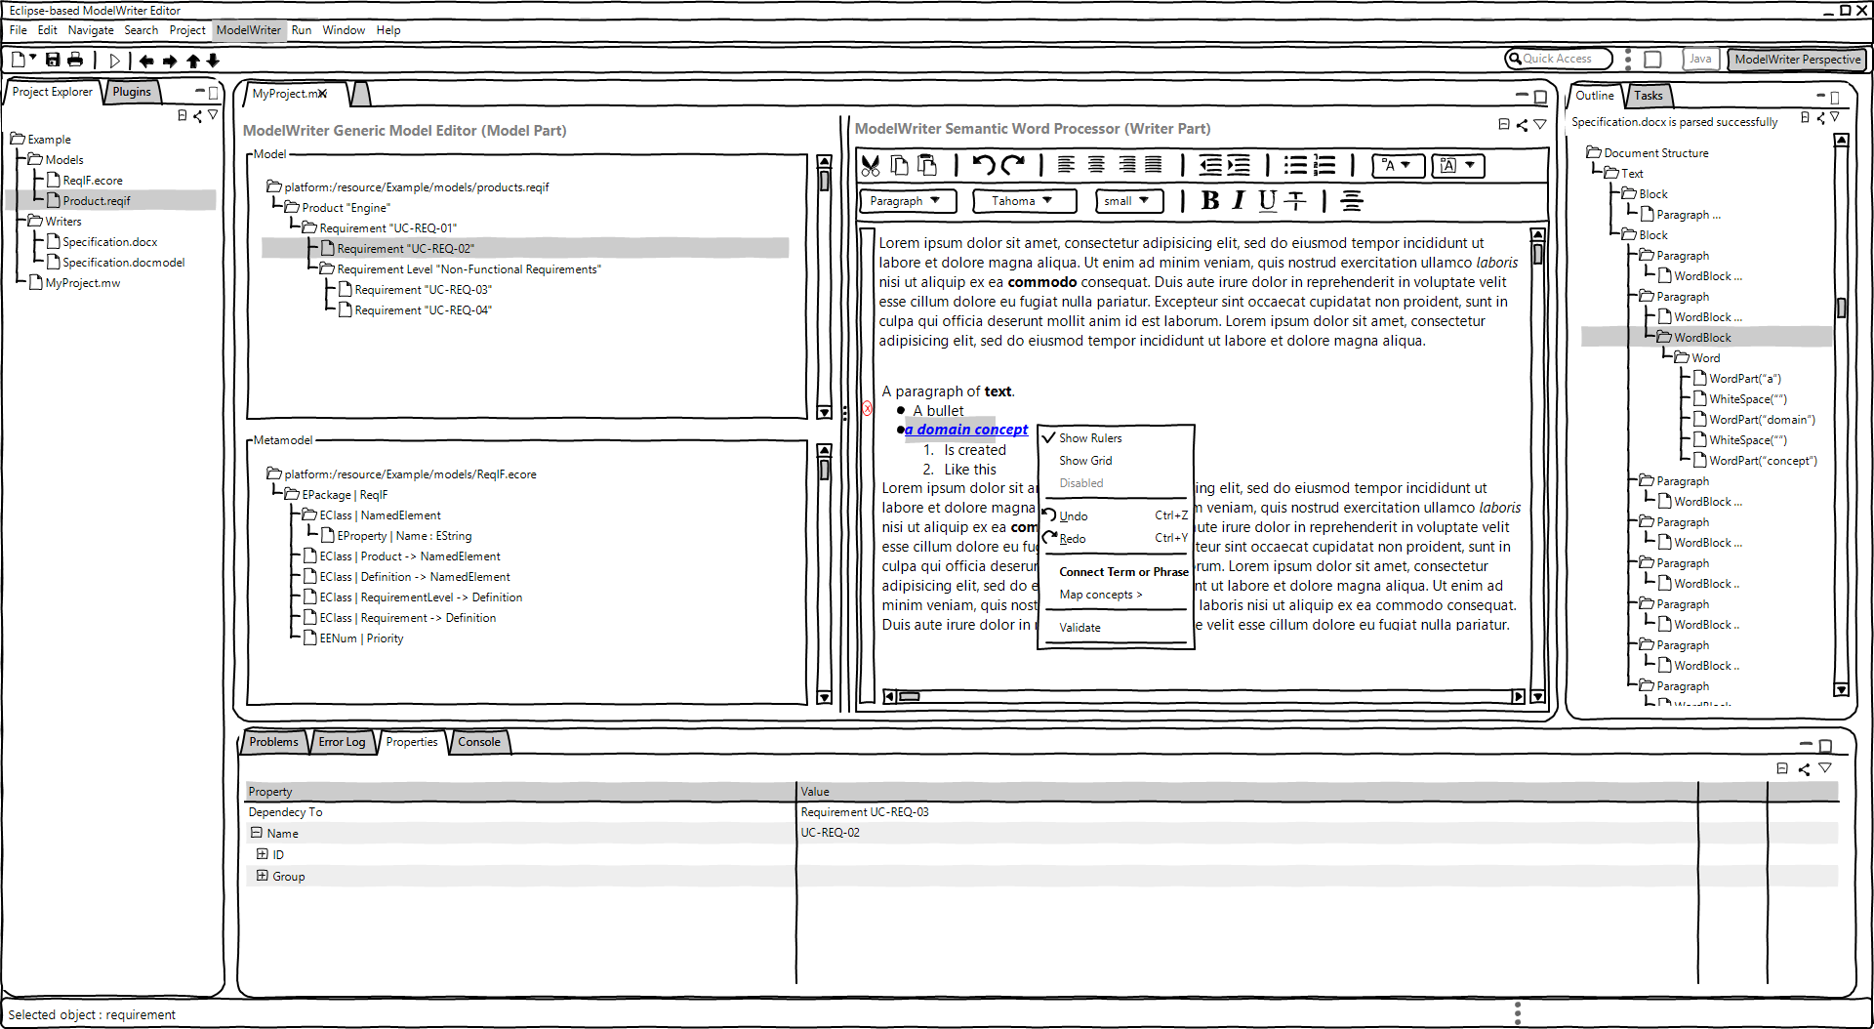
ModelWriter – The Solution
Text & Model-Synchronized Document Engineering Platform

Slide 22
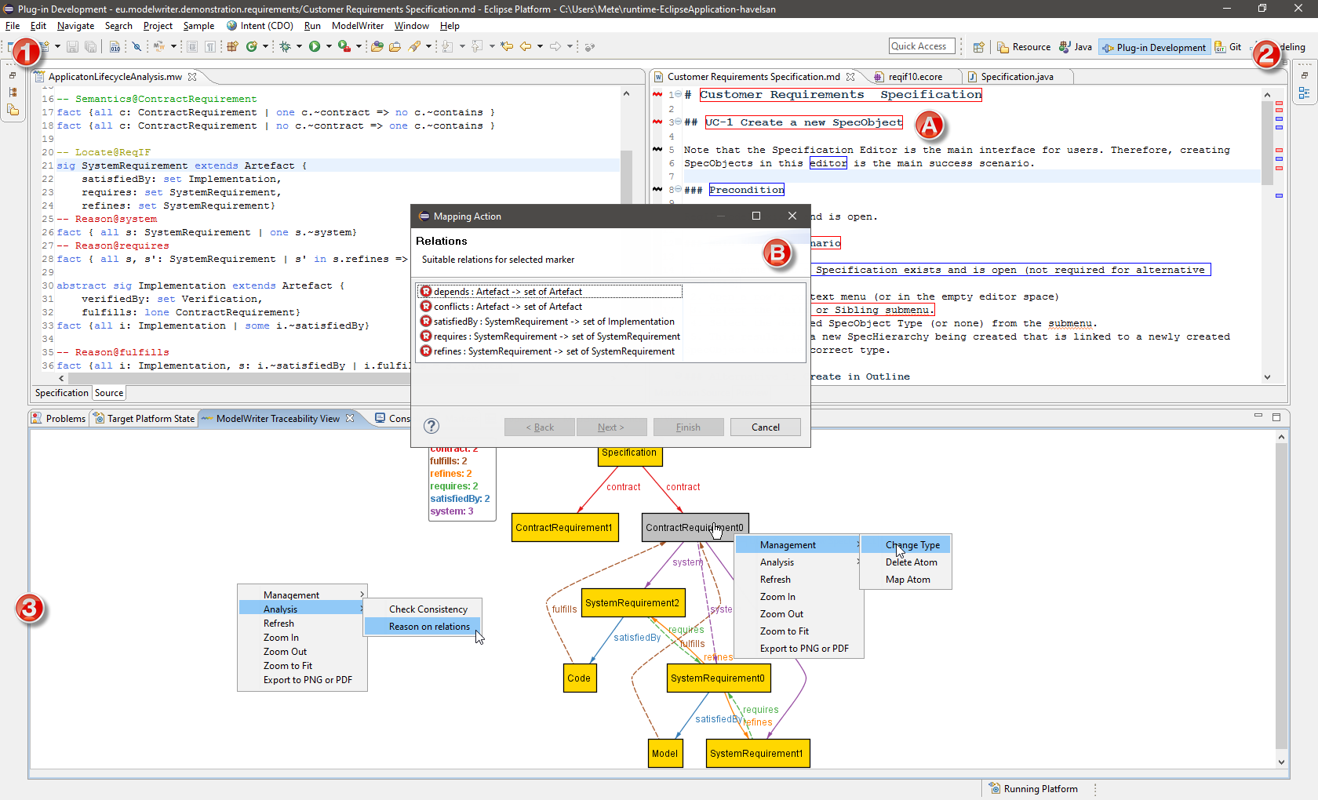
Solution – Knowledge Capture
Text & Model-Synchronized Document Engineering Platform

Slide 23
Is it possible to extract knowledge from texts fragments based on a given ontology (model) ?

Slide 24
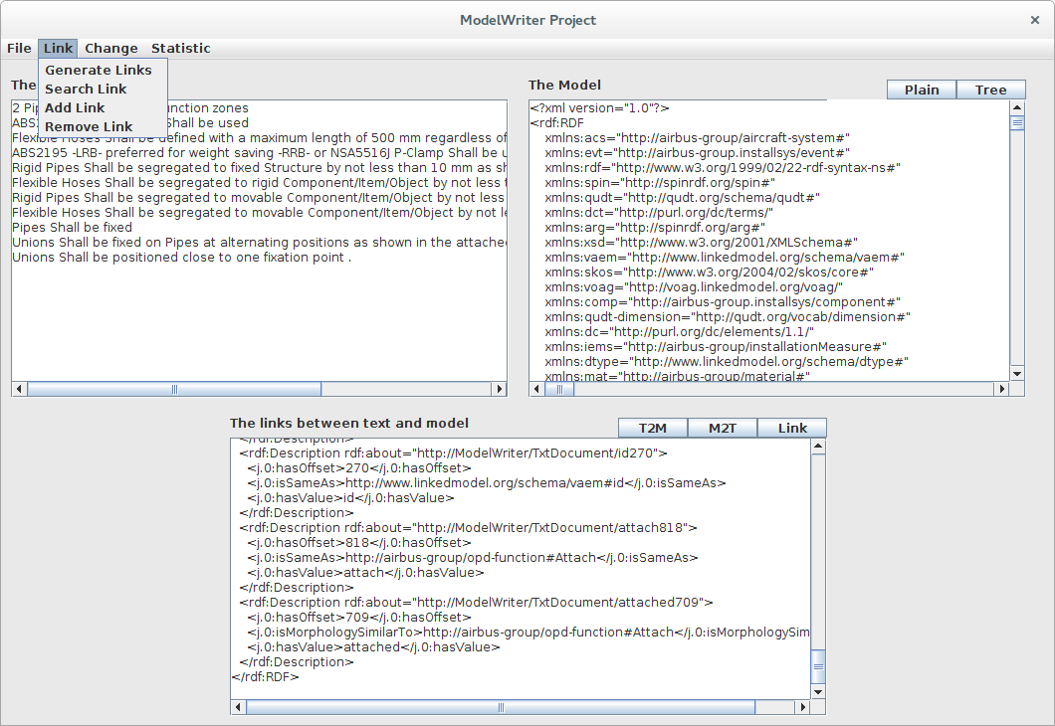
Solution – Knowledge Extraction
Text & Model-Synchronized Document Engineering Platform

Slide 25
Synchronization is maintained!

Slide 26
What about configuration/formalization of the platform?

Slide 27
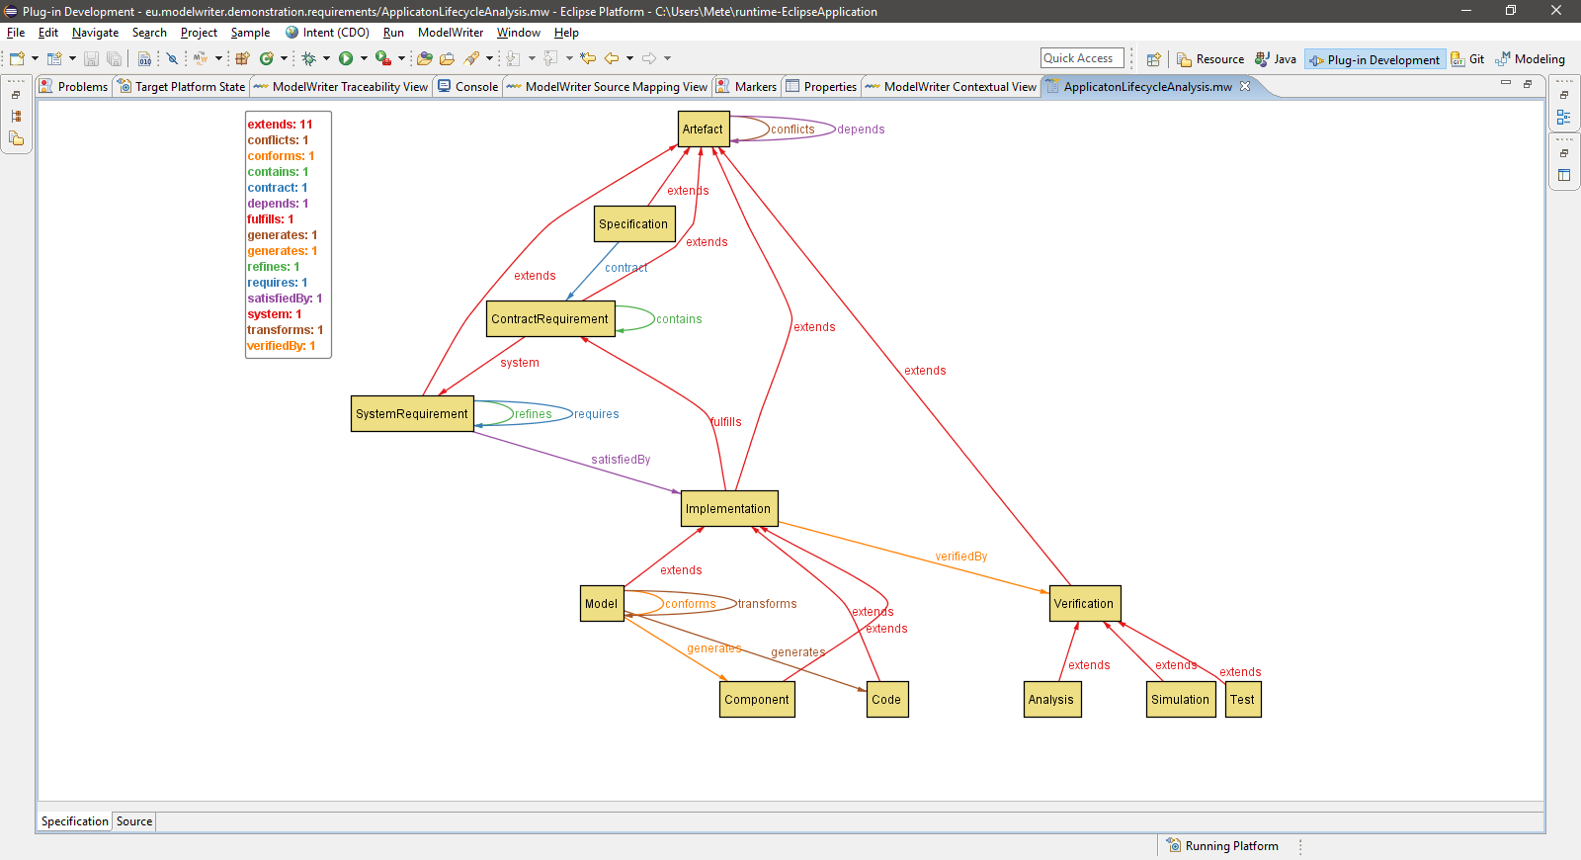
Configuration: Havelsan example
A Formal Specification Model to configure the ModelWriter

Slide 28
Is it possible to vizualize the trace links?

Slide 29
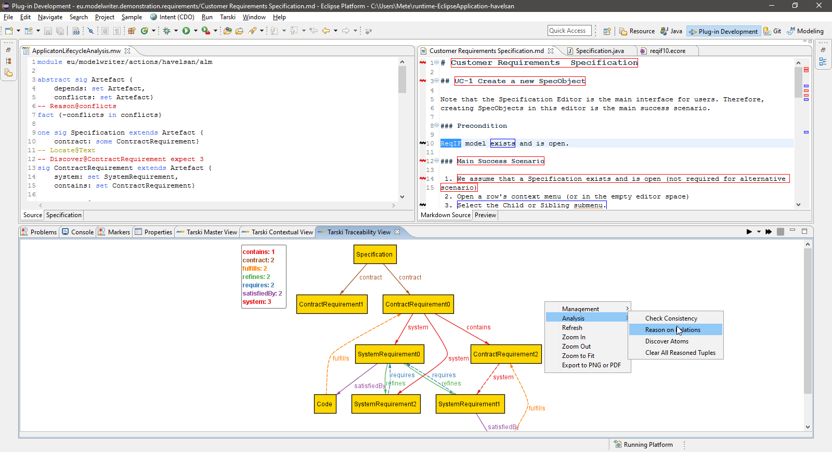
Traceability: Havelsan example
A Formal Specification Model to configure the ModelWriter

Slide 30
Airbus Use Cases

Slide 31
Ford-Otosan Use Case

Slide 32
Havelsan Use Case

